Slide 1
Marketing/Outreach
Idaho Dept. of Education
Melanie Reese

Slide 2
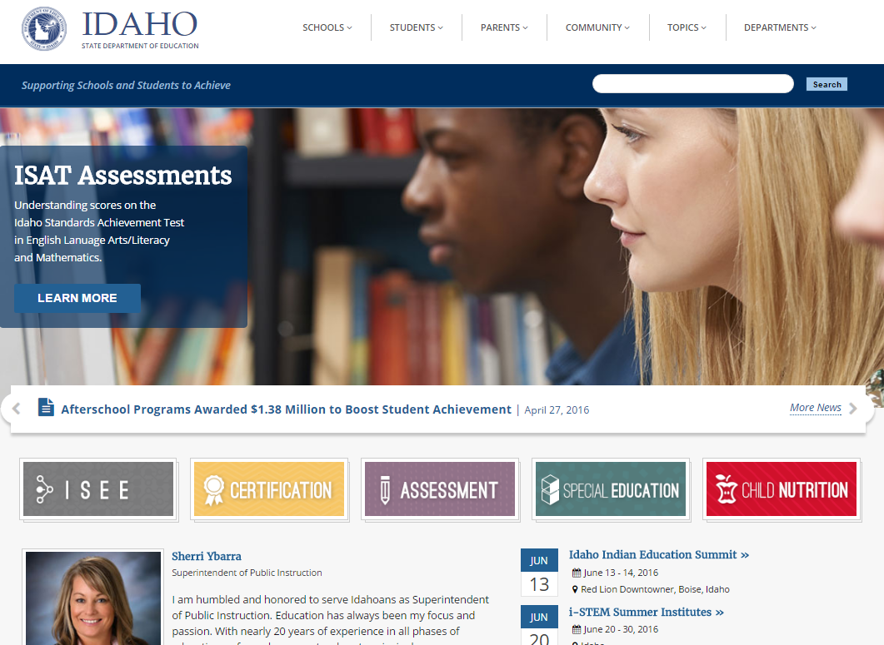
New Dept. Website
HOME PAGE: sde.idaho.gov

Slide 3
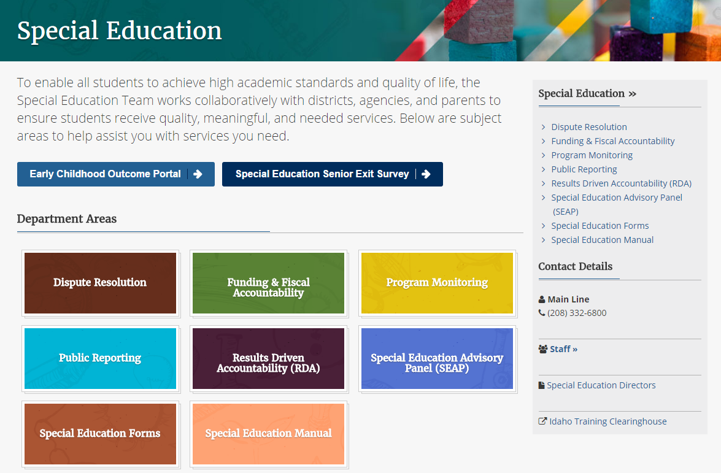
Special Ed Home Page

Slide 4
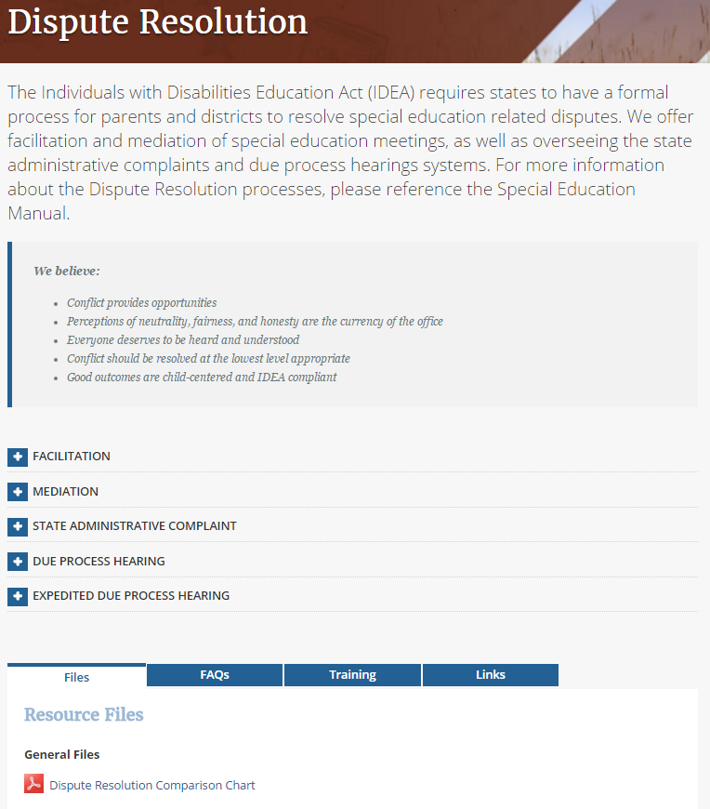
Dispute Resolution Page
Description of the scope of the DR office
Our Guiding Principles
(+) Expandable information buttons for each process
FAQs for each DR process

Slide 5
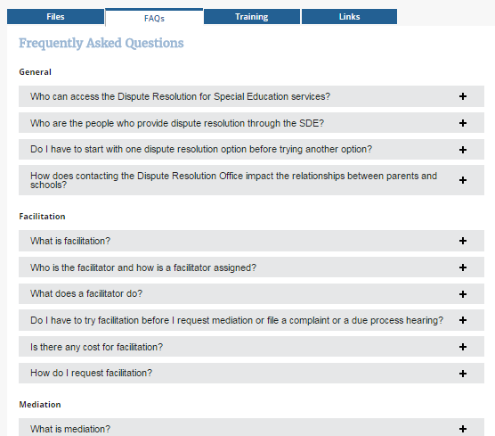
FAQs for Dispute Resolution

Slide 6
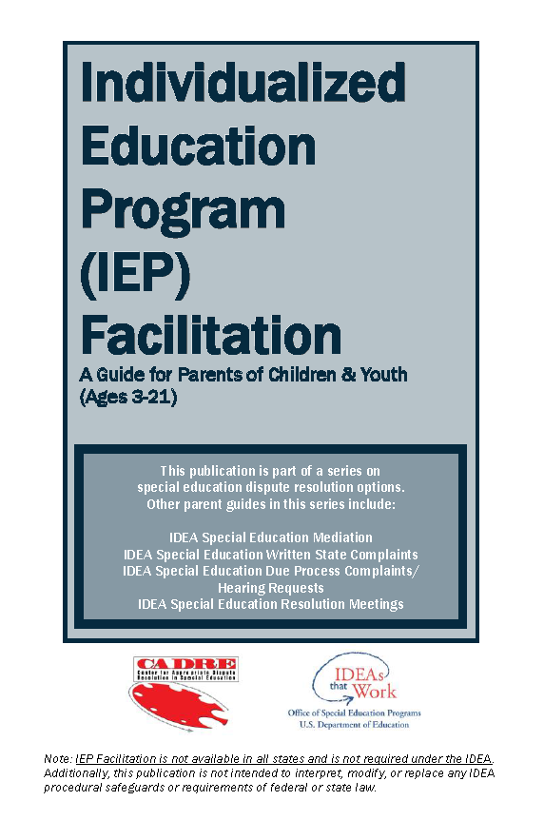
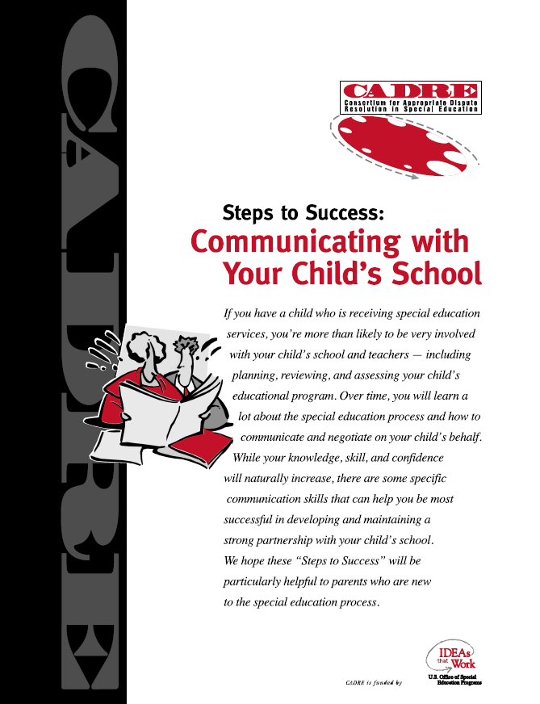
Materials for Participants
Facilitation participants receive:

Slide 7

Ongoing activity:

Slide 8
Consistent and Clear Messaging
Office of Dispute Resolution Guiding Principles
Conflict provides opportunities
Perceptions of neutrality, fairness, and honesty are the currency of the office
Everyone deserves to be heard and understood
Aim to resolve at the lowest level appropriate
Good outcomes are in the best interest of the child and are IDEA compliant

Slide 9

Outreach Activities
We are attention seekers and will jump in front of an audience to preach the DR gospel with little provocation.

Slide 10
DR Comparison 2004-2016
SUPPORTING SCHOOLS AND STUDENTS TO ACHIEVE
Notes:
By way of comparison: Last year (2014-15) at this time of year we had 119 facilitations and 17 complaints.

Slide 11
In State Activities in 2015-2016
Regional Director’s Meetings
Idaho Parent Group Meetings
Director’s Advisory Council and Special Education Advisor Panel
New Charter School Start Up Training
Various University Classes in Education, Law, and Dispute Resolution across state
New SPED Director’s Training
New SPED Teacher’s Training
State Superintendent’s Conference
Idaho Administrators School Assn. Conference
District In-service Presentations

Slide 12
Challenges
Not enough time to do what we want with a staff of 1 ½
Responding to any negatives immediately
Realizing that it’s a constant “sales” job to keep the value of facilitation in front of schools and districts
Making sure the message from our “champions” is also consistent

Slide 13

Questions?
SUPPORTING SCHOOLS AND STUDENTS TO ACHIEVE
SHERRI YBARRA, SUPERINTENDENT OF PUBLIC INSTRUCTION

Slide 14

SHERRI YBARRA, SUPERINTENDENT OF PUBLIC INSTRUCTION
SUPPORTING SCHOOLS AND STUDENTS TO ACHIEVE
SDE Dispute Resolution Office
Dr. Melanie Reese, Dispute Resolution Coordinator
Phone: (208) 332-6914
Email: mreese@sde.idaho.gov
Lily Robb, Dispute Resolution Program Specialist
Phone: (208) 332-6912
Email: lrobb@sde.idaho.gov

