Slide 1
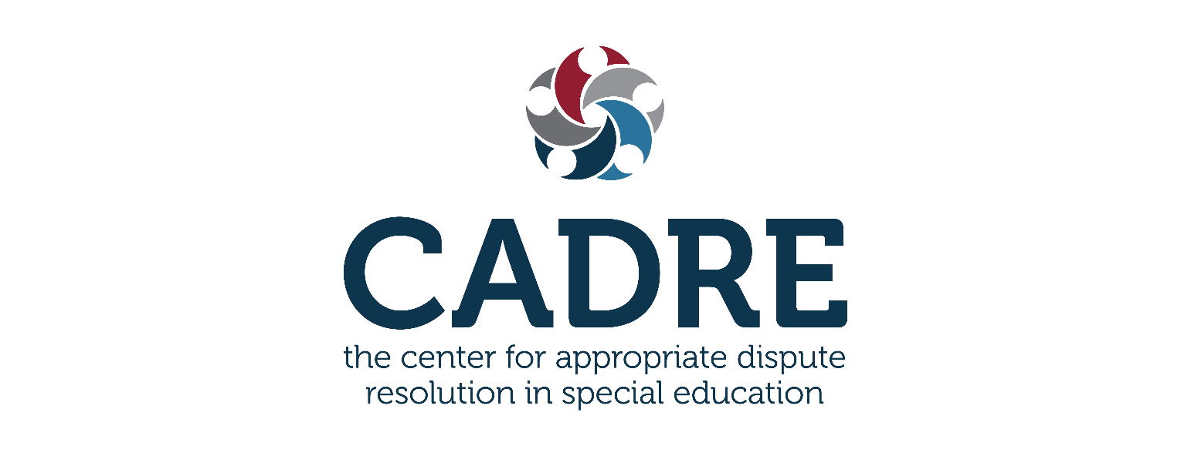
User Guide to CADRE’s Cultural & Linguistic Competence Assessment for DR Systems Phase 2: Completing the Self-assessment

Slide 2
Purpose
Not everything that is faced can be changed, but nothing can be changed until it is faced.
James Baldwin

Slide 3
Learning Objectives
Following this webinar, you will gain an understanding about:
the benefits of the tool
developing group norms
using CADRE’s companion resources
the organization of the self-assessment tool
key considerations and strategies for working through the tool as a team

Slide 4
Assessment Tool Tips
To best complete CADRE’s Cultural & Linguistic Competence Assessment for DR Systems, consider the following four tips:
COMPLETE A WALK THROUGH
DEVELOP GROUP NORMS
USE COMPANION RESOURCES
START WITH THE EASY PIECES

Slide 5
Benefits of a Walkthrough
WALKTHROUGH
TOOL
A walkthrough provides:
a framework for a cultural and linguistic dispute resolution system
insights for planning

Slide 6
Organization of the Tool
WALK THROUGH
TOOL
SYSTEMWIDE VALUES, INFRASTRUCTURE & ORGANIZATION
PROGRAM ACCESS & DELIVERY
PRACTITIONER STANDARDS & PROFESSIONAL DEVELOPMENT
PUBLIC AWARENESS & OUTREACH
EVALUATION & CONTINUOUS QUALITY IMPROVEMENT (CQI)

Slide 7
Function Area Descriptions
SYSTEMWIDE VALUES, INFRASTRUCTURE, AND ORGANIZATION
This section examines the system’s:
1) philosophy and values
2) worldview of cultural diversity
3) approaches to inclusion and equity
4) commitment to cultural and linguistic competence
It also examines the extent to which these view, philosophies, and values guide behavior and are established in policy.

Slide 8
Indicators

Slide 9
Ratings and Comments

Slide 10
Benefits of Group Norms
DEVELOP GROUP NORMS
Addressing cultural and linguistic competence in dispute resolution may lead to difficult conversations and evoke emotional and personal reactions.
Group norms can help:
Foster a feeling of inclusivity
Create a respectful and collaborative environment
Provide a container for responsive dialogue

Slide 11
Imagine…
DEVELOP GROUP NORMS
The team leader or facilitator can set an inclusive tone from the beginning by asking team members questions like:
What would make it easier for you to share your perspectives with each other?
What would it look like if we all promoted a culture of learning?
How would we behave to convey we value other’s contributions?

Slide 12
Consider…
DEVELOP GROUP NORMS
Developing group norms as a team
Reviewing group norms at the beginning of each meeting
Revisiting the group norms as needed

Slide 13
CADRE’s Companion Resources
Sample Norms
Glossary of Terms
Action Planning Tool
Coaching Questions
And More!
USE COMPANION RESOURCES

Slide 14
Companion Resources
Glossary – Terms found in the self-assessment to assist in shared understanding.
Action Planning Tool – A roadmap for achieving desired outcomes.
Coaching Questions – Guidance through the function areas; a great resource for when and if the team gets stuck.
USE COMPANION RESOURCES

Slide 15
Supplemental Resources on CADRE’s Website:
Webinars & Training Websites Data Resources Miscellaneous Resources

Slide 16
Start with the Easy Pieces
START WITH THE EASY PIECES
Begin with a section that presents the fewest obstacles.

Slide 17
Slow, Methodical Progress
Remember, this is a journey, and not a race.
Focus on one function area at a time.
Take a break after completing each section.
Consider everyone’s views before proceeding.

Slide 18
Have questions or need assistance?
Contact us at:
cadre@directionservice.org

